Slide 1

6th Grade Accelerated Math
Unit 13, Lesson 11 What Values Make an Equation or Inequality True? Volume 2, pg. 320

Slide 2


Benchmark
MA.6.AR.2.1
Given an equation or inequality and a specified set of integer values, determine which values make the equation or inequality true or false.
volume 2, pg. 320

Slide 3
Integrated Mathematical Thinking and Reasoning Standards
MA.K12.MTR.1.1 Actively participate in effortful learning both individually and collectively.
MA.K12.MTR.4.1 Engage in discussions that reflect on the mathematical thinking of self and others.
MA.K12.MTR.5.1 Use patterns and structure to help understand and connect mathematical concepts.
MA.K12.MTR.6.1 Assess the reasonableness of solutions.
volume 2, pg. 320

Slide 4

Learning Target
I can determine if a given integer value makes an equation or inequality true.
volume 2, pg. 320

Slide 5

Warm-Up
volume 2, pg. 321

Slide 6
13.11.1 Warm-Up: Day at Work – Film Composer
Shohan Cagle is a film composer. He writes music for commercials and soundtracks for TV shows and movies.
What did you notice about what he does to write a soundtrack?
Shohan said that most people say they don’t normally hear the soundtrack. Name a TV show or a movie whose soundtrack you remember.
Shohan mentioned that one of his challenges is a short deadline. He said that his strategy to get his work done is “to sit and focus and get in the right mindset”. How can you use Shohan’s strategy?
volume 2, pg. 321

Slide 7

Guided Instruction
volume 2, pg. 321

Slide 8

13.11.2 Guided Instruction: Determining Values That Make an Equation True or False
An equation is a mathematical relation statement where two equivalent expressions and values are separated by an equal sign.
In the equation $4x+5=8x−23$, what are the two expressions?
volume 2, pg. 321

Slide 9
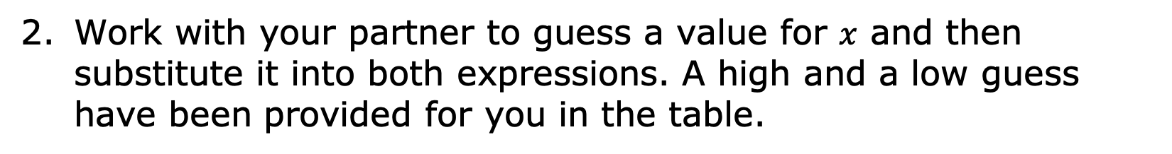
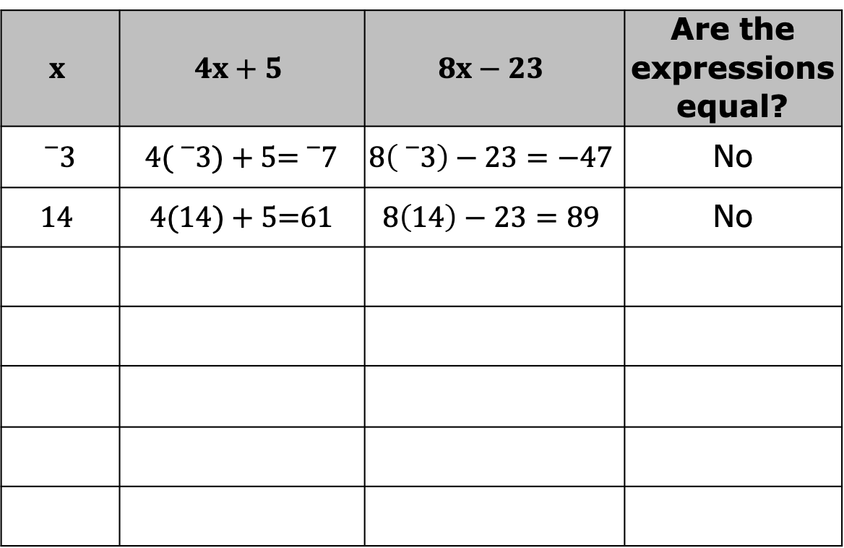
Work with your partner to guess a value for $x$ and then substitute it into both expressions. A high and a low guess have been provided for you in the table.
$$x$$ | $$4x+5$$ | $$8x−23$$ | Are the expressions equal?
$${}_{}^{−}3$$ | $4({}_{}^{−}3)+5$=${}_{}^{−}7$ | $$8\left({}_{}^{−}3\right)−23=−47$$ | No
$$14$$ | $4(14)+5$=$61$ | $$8\left(14\right)−23=89$$ | No
volume 2, pg. 321

Slide 10
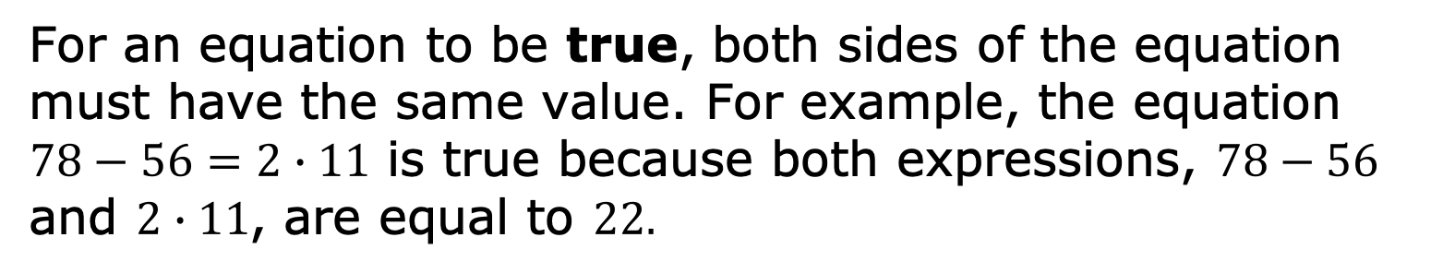
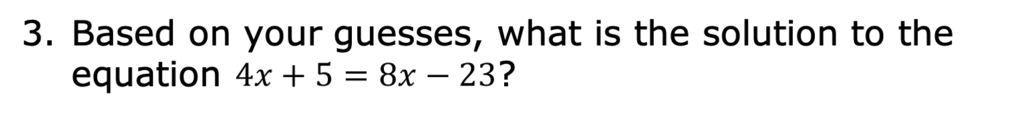
For an equation to be true, both sides of the equation must have the same value. For example, the equation
$78−56=2∙11$ is true because both expressions, $78−56$ and $2∙11$, are equal to $22.$
The solution of an equation is the value(s) that, when substituted in for the variable(s), makes the equation true.
Based on your guesses, what is the solution to the equation $4x+5=8x−23$?
volume 2, pg. 322

Slide 11
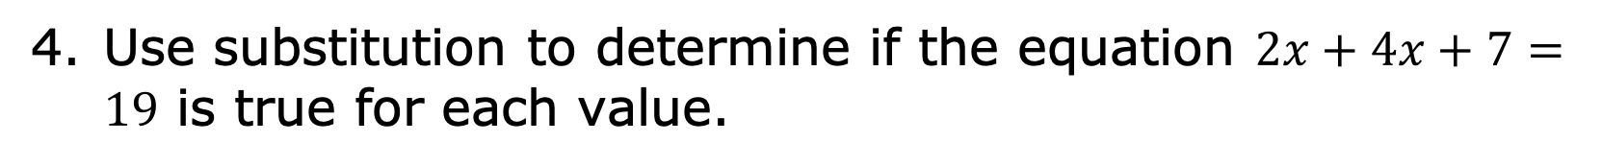
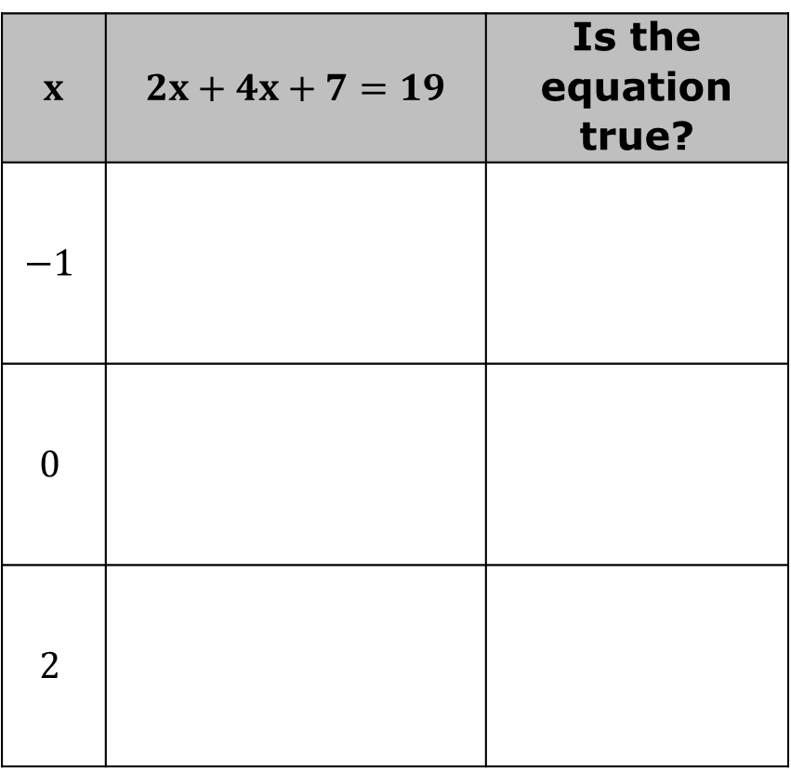
Use substitution to determine if the equation $2x+4x+7=19$ is true for each value.
$x$ | $2x+4x+7=19$ | Is the equation true?
$$−1$$
$$0$$
$$2$$
volume 2, pg. 322

Slide 12
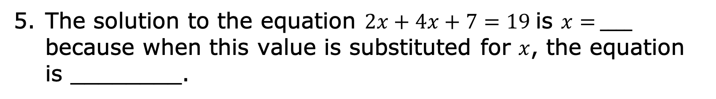
The solution to the equation $2x+4x+7=19$ is $x=$ ____ because when this value is substituted for $x$, the equation is ________.
volume 2, pg. 322

Slide 13

Guided Practice
volume 2, pg. 323

Slide 14

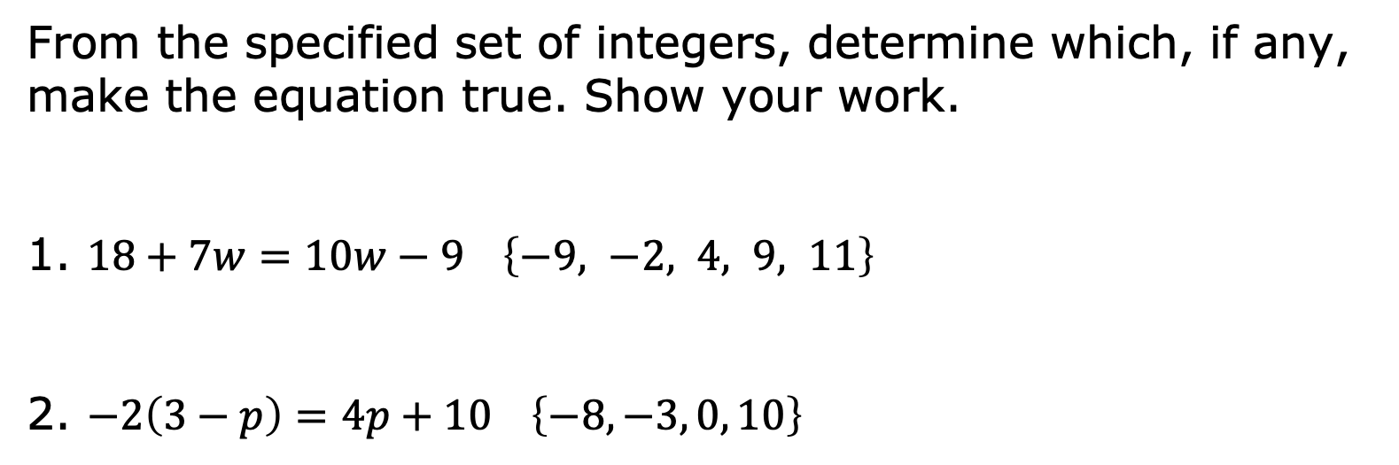
13.11.3 Guided Practice: Determining Which Values Make an Equation True or False
From the specified set of integers, determine which, if any, make the equation true. Show your work.
1. $18+7w=10w−9$ $\left\{−9, −2, 4, 9, 11\right\}$
2. $−2\left(3−p\right)=4p+10$ $\left\{−8, −3, 0, 10\right\}$
volume 2, pg. 323

Slide 15
Guided Instruction
volume 2, pg. 323

Slide 16
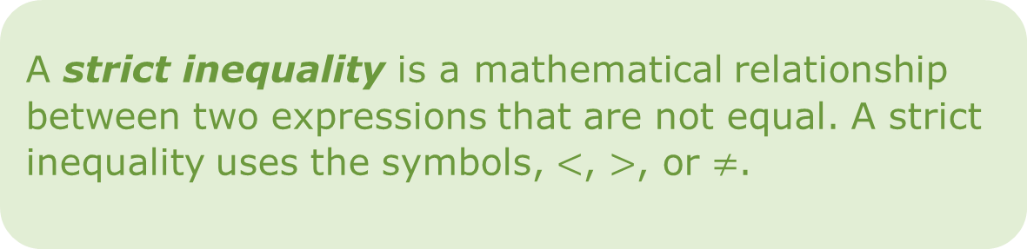
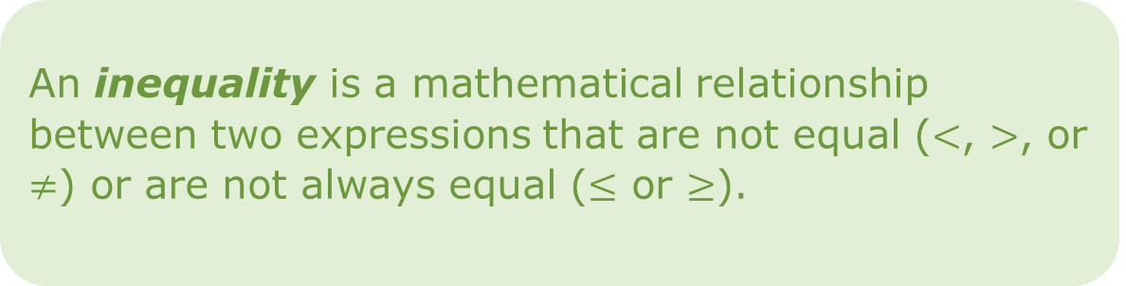
13.11.4 Guided Instruction: Determining Values That Make an Inequality True or False
An inequality is a mathematical relationship between two expressions that are not equal ($<$, $>$, or $≠$) or are not always equal ($≤$ or $≥$).
A strict inequality is a mathematical relationship between two expressions that are not equal. A strict inequality uses the symbols, $<$, $>$, or $≠$.
volume 2, pg. 323

Slide 17
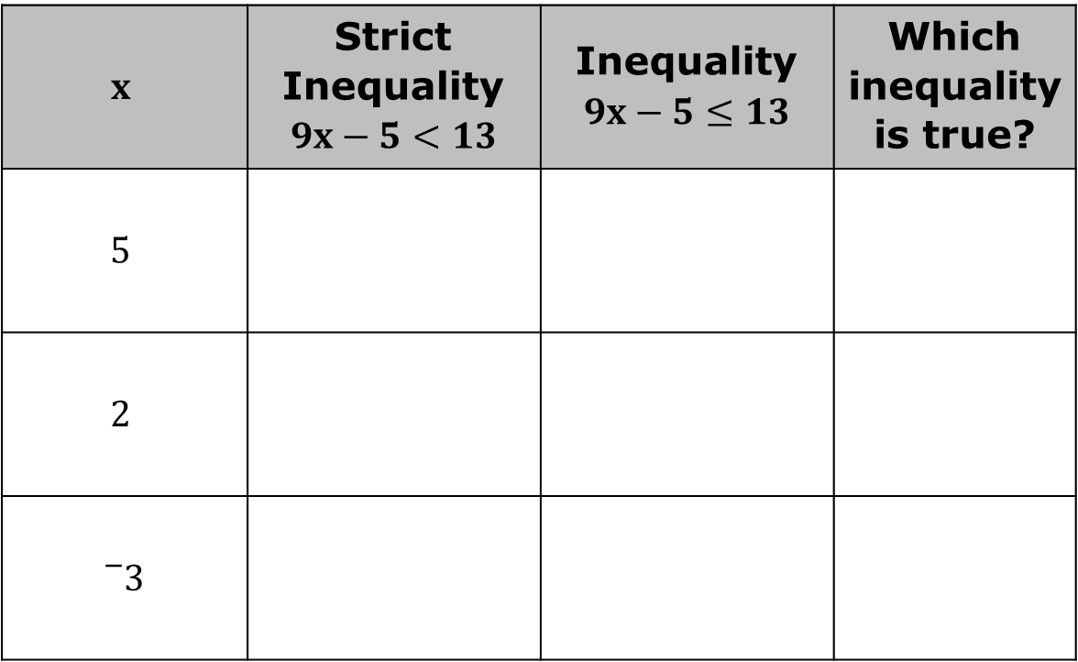
Use substitution to evaluate the mathematical statement. Then determine if each inequality is true for the value of $x$.
$$x$$ | Strict Inequality $$9x−5<13$$ | Inequality $$9x−5≤13$$ | Which inequality is true?
$$5$$
$$2$$
$${}_{}^{−}3$$
volume 2, pg. 323

Slide 18
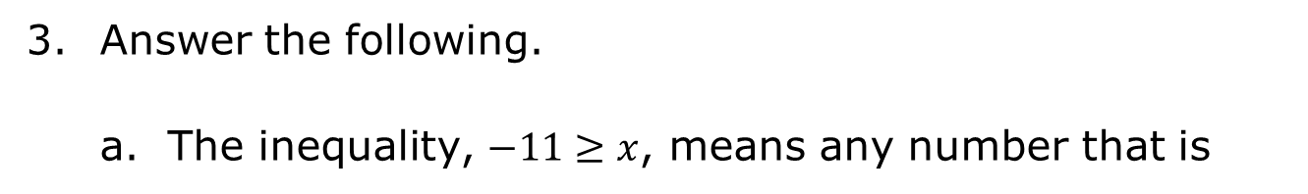
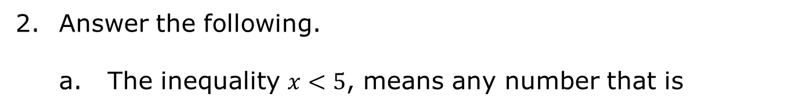
Answer the following.
The inequality $x<5$, means any number that is
smaller
larger
than 5 will make the inequality true.
List four numbers that are not integers that make the inequality true.
Answer the following.
The inequality, $−11≥x$, means any number that is
smaller
larger
than -11 will make the inequality true.
List four numbers that are not integers that make the inequality true.
volume 2, pg. 324

Slide 19
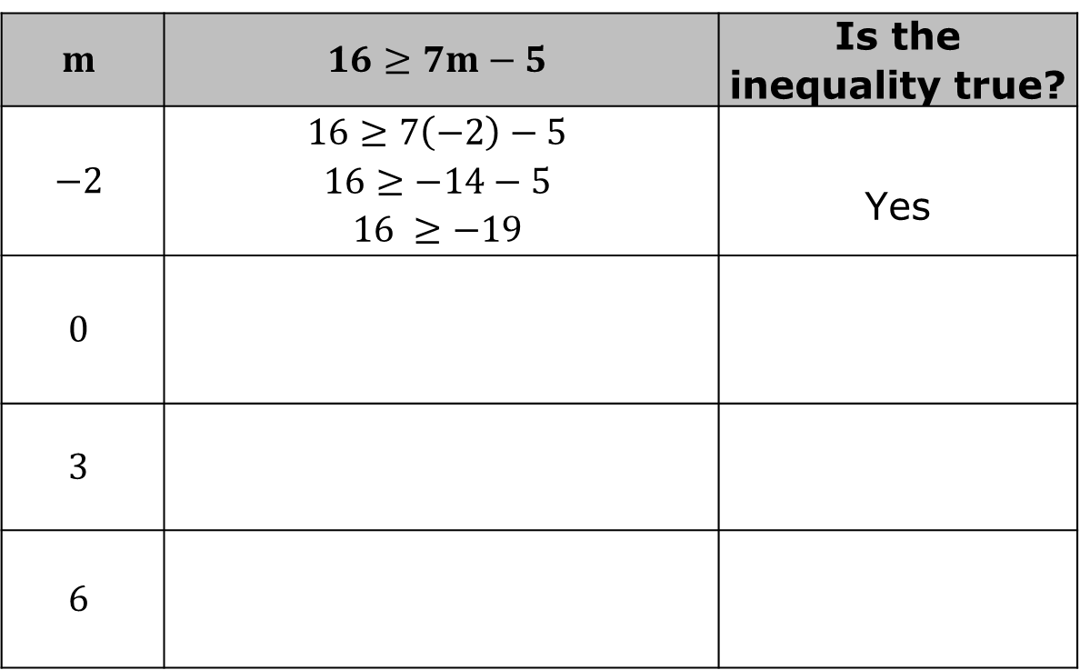
Use substitution to determine if the inequality $16≥7m−5$ is true for each value specified for $m$.
$$m$$ | $$16≥7m−5$$ | Is the inequality true?
$$−2$$ | $$16≥7\left(−2\right)−5$$ $$16≥−14−5$$ $$16 ≥−19$$ | Yes
$$0$$
$$3$$
$$6$$
volume 2, pg. 324

Slide 20
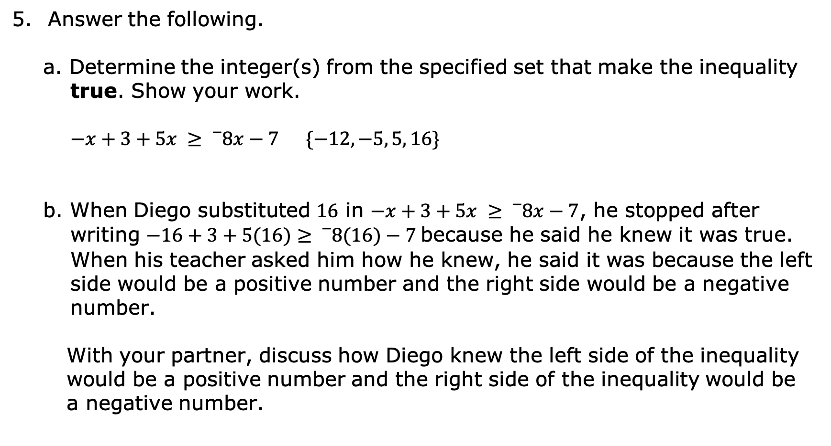
Answer the following.
a. Determine the integer(s) from the specified set that make the inequality true. Show your work.
$−x+3+5x ≥{}_{}^{−}8x−7$ $\{−12, −5, 5, 16\}$
b. When Diego substituted $16$ in $−x+3+5x ≥{}_{}^{−}8x−7$, he stopped after writing $−16+3+5(16)≥{}_{}^{−}8(16)−7$ because he said he knew it was true. When his teacher asked him how he knew, he said it was because the left side would be a positive number and the right side would be a negative number.
With your partner, discuss how Diego knew the left side of the inequality would be a positive number and the right side of the inequality would be a negative number.
volume 2, pg. 325

Slide 21
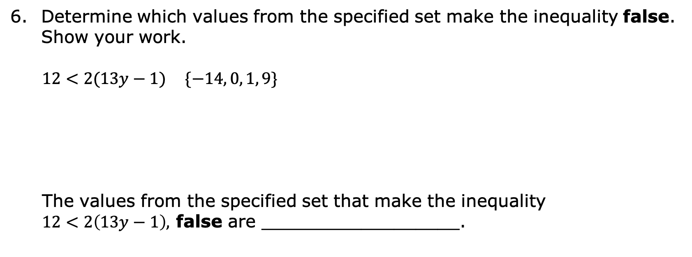
Determine which values from the specified set make the inequality false. Show your work.
$12<2(13y−1)$ $\{−14, 0, 1, 9\}$
The values from the specified set that make the inequality
$12<2\left(13y−1\right),$ false are __________________.
volume 2, pg. 325

Slide 22

Your Turn
volume 2, pg. 326

Slide 23
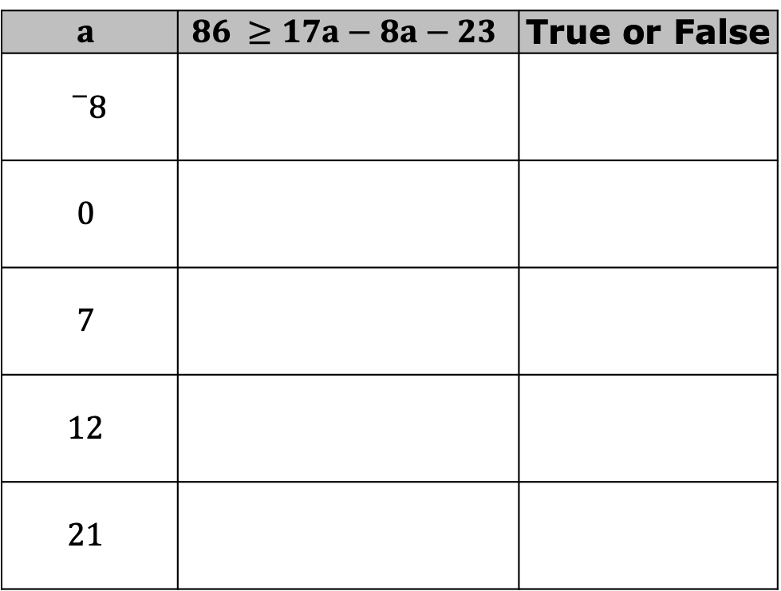
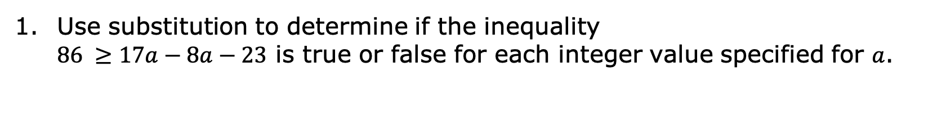
13.11.5 Your Turn!
Use substitution to determine if the inequality
$86 ≥17a−8a−23$ is true or false for each integer value specified for $a$.
$$a$$ | $$86 ≥17a−8a−23$$ | True or False
$${}_{}^{−}8$$
$$0$$
$$7$$
$$12$$
$$21$$
volume 2, pg. 326

Slide 24

Wrap-Up
volume 2, pg. 326

Slide 25
13.11.6 Wrap-Up: Reflection
One question I still have after today’s lesson is …
_______________________________________________
_______________________________________________
______________________________________________?
Today I am still unsure about …
_______________________________________________
_______________________________________________
______________________________________________.
volume 2, pg. 326

Slide 26
To fill in this gap I intend to …
_______________________________________________
_______________________________________________
______________________________________________.
volume 2, pg. 326

